Slide 1
Aspects of Microservice Interactions

Slide 2

WHY?

Slide 3
Characteristics
Independently Deployable
Polyglot
Autonomous

Slide 4

NETWORK CALL
Notes:
No SRP, no microservice size, etc…

Slide 5
Driving Forces
availability
reliability
latency
queuing theory
Conway’s law

Slide 6
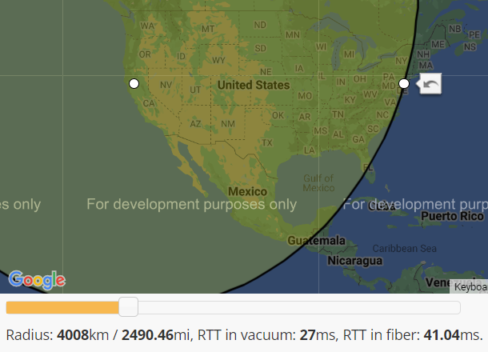
Latency
Notes:
Density of the material
Fiber is 1.5x slower
Eventual Consistency
Pressure increasing replication latency leads to increase of replication lag

Slide 7
Availability
96%
99%
99%
CPU
RAM
99%
Network
Disk
99%

Slide 8
Availability
88.5%
99%
99%
99%
99%
99%
99%
99%
99%
99%
99%
99%
99%
CLIENT
SERVER
DB

Slide 9
Reliability
CPU
RAM
CPU
RAM
Network
Network
Disk
Disk
CLIENT
SERVER
Notes:
2PC !!!
TCP leaky abstraction
CAP theorem
Timeouts
Retries
Idempotence
Rapid-Read protection

Slide 10
Reliability

Slide 11
Queuing Theory
processing
time
latency
arrival rate
exit rate

Slide 12
Queuing Theory
>
arrival rate
exit rate
backpressure!
Notes:
Latency increase infinitely
Utilization > 1 (arrival/exit)

Slide 13
Queuing Theory
100ms
latency = 800ms
10/s

Slide 14
Queuing Theory
100ms
latency = 400ms
100ms
20/s

Slide 15
Queuing Theory
50ms
50ms
latency = 800ms
20/s

Slide 16
Queuing Theory
100ms
50ms
latency = 1200ms
10/s

Slide 17
Queuing Theory
latency = sum(processing time / parallelism) * queue length
throughput = min(parallelism / processing time)

Slide 18
Queuing Theory
QoS?

Slide 19
Queuing Theory
QoS
QoS
QoS

Slide 20

Conway’s Law

Slide 21

Conway’s Law

Slide 22

Conway’s Law

Slide 23
Conway’s Law
Schema Owner

Slide 24
Conway’s Law
Schema Owners

Slide 25

Conway’s Law
Schema
Federation

Slide 26
TOOLBOX

Slide 27

CQRS
SCHEMAS
CONTRACT-BASED TESTS
SYNC TO ASYNC
POLLING, FAKE BOUNDARIES
CACHING
MULTI-WRITES
CLOUD NATIVE
AUTO-SCALING
BACKPRESSURE
SAGA
ORCHESTRATION, COREOGRAPHY
12 FACTOR
SERVICE MESH
TECHNOLOGY
GRPC, REST, GRAPHQL
MESSAGING
CORRELATION ID, ROUTING SLIP, EXACTLY ONCE
TOPICS VS QUEUES
CONCURRENCY MODEL
REACTIVE, ACTOR-BASED, COROUTINES
RESILIENCY PATTERNS
CIRCUIT BREAKER, BULKHEAD, RETRIES, TIMEOUTS
OBSERVABILITY
SLO, TRACING, METRICS, LOGS

Slide 28
EXAMPLES

Slide 29

Rapid Read Protection
Client
99%
99%
~ 99.99 %
Notes:
Idempotence
Timeouts
Retries

Slide 30

WRITE
READ
Read-heavy workload
Immutable writes
Low latency baseline
Cold Cache & Distributed Cache won’t work
Notes:
Very read-heavy workflow
Tight latency requirement
Cold cache & distributed cache is not an option (thundering herd problem)

Slide 31


CQRS
WRITE
READ
READ
READ
Replication
Amazon Simple Queue Service (Amazon SQS)
Amazon DynamoDB
Notes:
Multi-writes
SYNC to ASYNC
BACKPRESSURE
- Alternative => DAX

Slide 32

Region Pinning
~60ms
Replication Lag

Slide 33
Region Pinning
~60ms
Replication Lag

Slide 34


Going...Going...Gone!
~60ms
Mirror Maker
Notes:
Availability -> 99,99%
Consistency under 100ms

Slide 35

Recent Keys
Values
Throttling
=
WCU
RCU

Slide 36
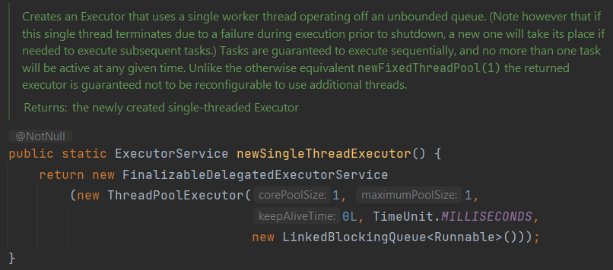
Separate Critical Path
Recent Keys
Values
Notes:
OOMKilled – Kubernetes memory limits

Slide 37
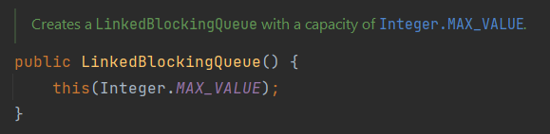
Separate Critical Path
Recent Keys
Values
Notes:
OOMKilled – Kubernetes memory limits

Slide 38
Separate Critical Path
Recent Keys
Values
Circuit Breaker + Bulkhead
<
WCU
RCU
Notes:
CB reacts if bulkhead is full.
Meter bulkhead and DynamoDB throttling

Slide 39

Baseline
15,000 items
Auto Scaling group
HTTP 400
RCU = 400
Notes:
- TODO calculations
- TODO metrics

Slide 40

Retries
No Fairness
Auto Scaling group
HTTP 400
RCU = 400
Retry
Notes:
- TODO calculations
- TODO metrics

Slide 41
Built In Rate-Limiting
Auto Scaling group
40/s
HTTP 400
40/s
RCU = 400
80/s
Notes:
- TODO calculations
- TODO metrics

Slide 42
Built In Rate-Limiting
Rate-Limit Changes
Auto Scaling group
40/s
40/s
HTTP 400
RCU = 400
40/s
120/s
Notes:
- TODO calculations
- TODO metrics

Slide 43


Service Mesh
Needs API Change
Auto Scaling group
HTTP 429
HTTP 400
RCU = 400
120/s
Notes:
- TODO calculations
- TODO metrics

Slide 44
Queuing Theory
15,000 items
4ms
latency = 30s
4ms
500/s

Slide 45
Queuing Theory
10ms
15,000 items
10ms
10ms
latency = 30s
10ms
500/s
10ms

Slide 46
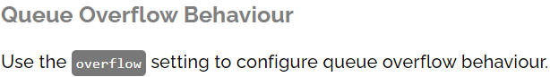
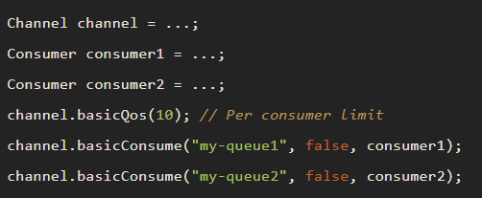
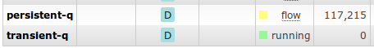
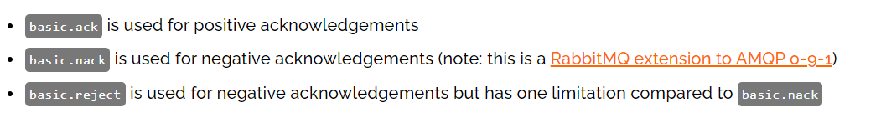
Moving Towards RabbitMQ

Slide 47

Separate by API Keys
Auto Scaling group
API Key
Auto Scaling group
Service
Worker
RCU

Slide 48
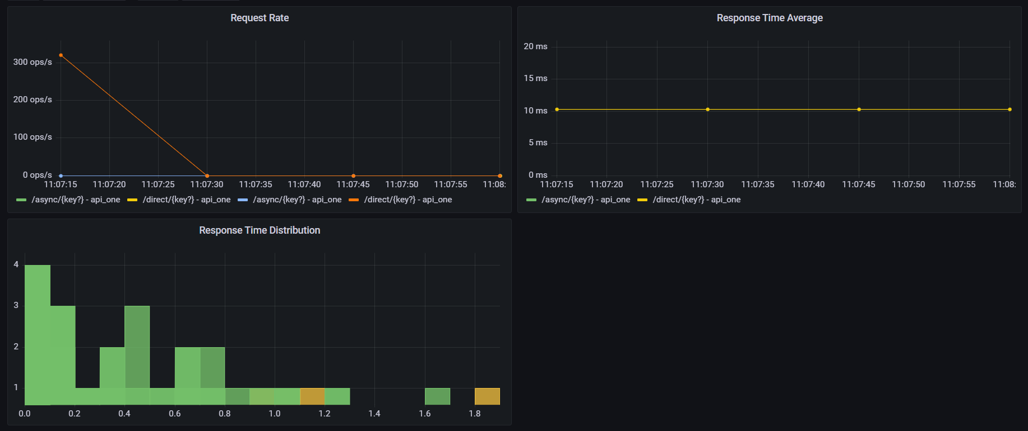
Direct Write

Slide 49
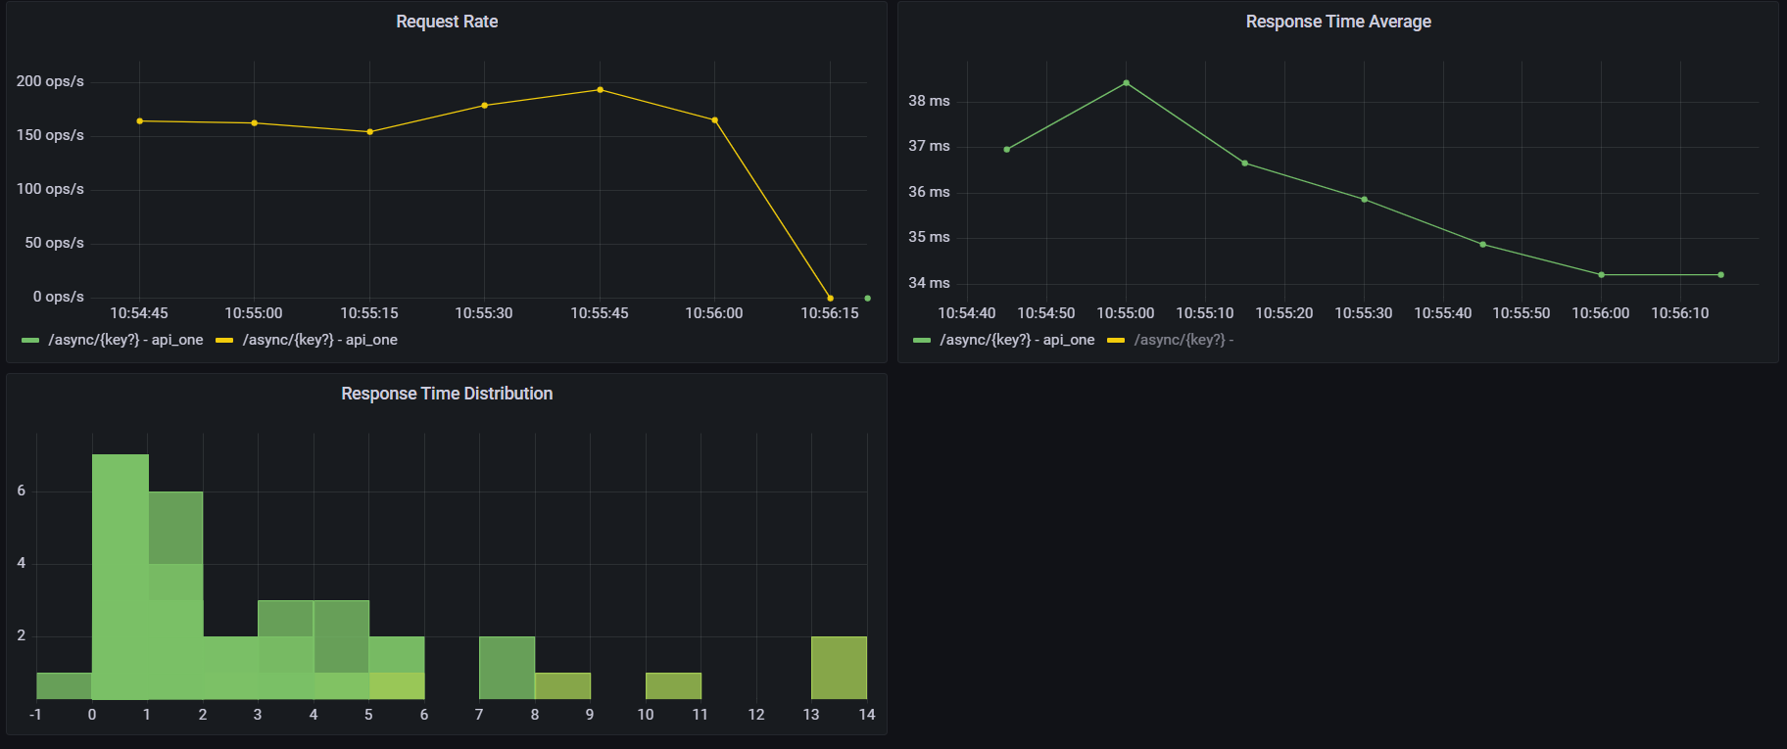
Single Worker
Notes:
TODO - scale

Slide 50
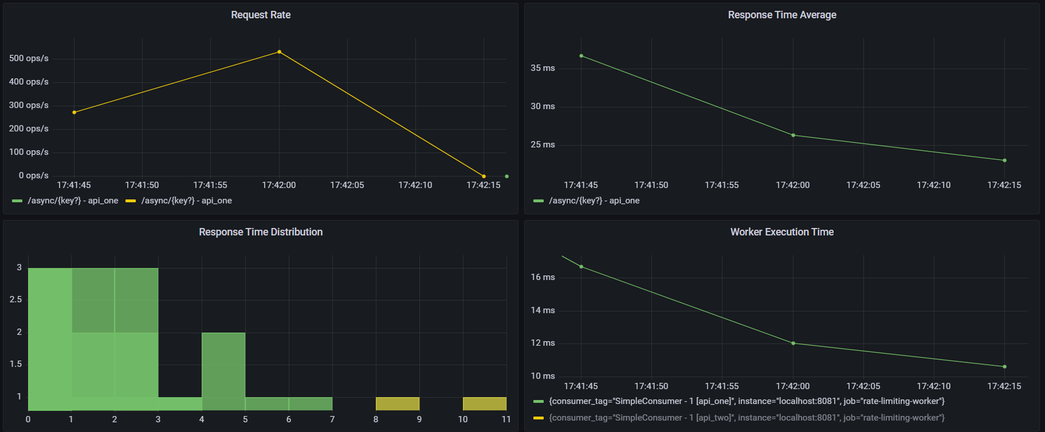
Five Workers
Notes:
TODO - scale

Slide 51
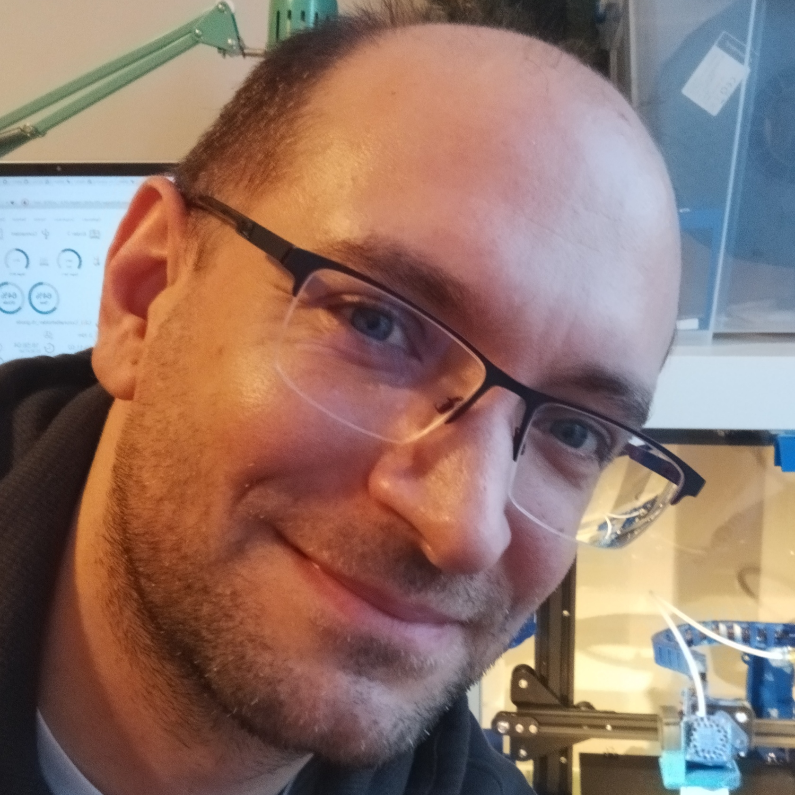



Thank You!
@gitaroktato
gitaroktato
https://www.linkedin.com/in/oresztesz
ORESZTÉSZ MARGARITISZ
ASSOCIATE CHIEF SOFTWARE ENGINEER

Slide 52
ZC5P

Slide 53
References
Latency
https://www.igvita.com/2012/07/19/latency-the-new-web-performance-bottleneck/
https://docs.google.com/a/chromium.org/viewer?a=v&pid=sites&srcid=Y2hyb21pdW0ub3JnfGRldnxneDoxMzcyOWI1N2I4YzI3NzE2
https://www.cloudping.co/
https://aws-latency-test.com/
https://colin-scott.github.io/personal_website/research/interactive_latency.html
https://gist.github.com/jboner/2841832
https://blog.bytebytego.com/p/ep22-latency-numbers-you-should-know
Availability
https://github.com/gitaroktato/microservices-availability-simulator
https://eventhelix.com/fault-handling/system-reliability-availability
https://eventhelix.com/fault-handling/reliability-availability-basics
https://en.wikipedia.org/wiki/Fallacies_of_distributed_computing
Notes:
Latency:
https://www.igvita.com/2012/07/19/latency-the-new-web-performance-bottleneck/
https://docs.google.com/a/chromium.org/viewer?a=v&pid=sites&srcid=Y2hyb21pdW0ub3JnfGRldnxneDoxMzcyOWI1N2I4YzI3NzE2
https://www.cloudping.co/
https://aws-latency-test.com/
https://colin-scott.github.io/personal_website/research/interactive_latency.html
https://gist.github.com/jboner/2841832
https://blog.bytebytego.com/p/ep22-latency-numbers-you-should-know
Availability:
https://github.com/gitaroktato/microservices-availability-simulator
https://eventhelix.com/fault-handling/system-reliability-availability/
https://eventhelix.com/fault-handling/reliability-availability-basics/
https://en.wikipedia.org/wiki/Fallacies_of_distributed_computing
Backpressure with SQS
https://d1.awsstatic.com/architecture-diagrams/ArchitectureDiagrams/unreal-engines-pixel-streaming-on-aws-ra.pdf?did=wp_card&trk=wp_card
Reliability:
https://www.joelonsoftware.com/2002/11/11/the-law-of-leaky-abstractions/
Queuing Theory
https://www.youtube.com/watch?v=oQGreeij-OE
https://www.youtube.com/watch?v=raRpbsWQBCo
https://en.wikipedia.org/wiki/Little%27s_law
Rapid-Read Protection:
http://www.datastax.com/dev/blog/rapid-read-protection-in-cassandra-2-0-2
Katas: https://nealford.com/katas/kata?id=GoingGoingGone
Kafka / Kinesis Multi-Region: https://aws.amazon.com/blogs/big-data/increase-apache-kafkas-resiliency-with-a-multi-region-deployment-and-mirrormaker-2/
https://aws.amazon.com/blogs/big-data/build-highly-available-streams-with-amazon-kinesis-data-streams/

Slide 54
References
Backpressure with SQS
https://d1.awsstatic.com/architecture-diagrams/ArchitectureDiagrams/unreal-engines-pixel-streaming-on-aws-ra.pdf?did=wp_card&trk=wp_card
Reliability
https://www.joelonsoftware.com/2002/11/11/the-law-of-leaky-abstractions/
Queuing Theory
https://www.youtube.com/watch?v=oQGreeij-OE
https://www.youtube.com/watch?v=raRpbsWQBCo
https://en.wikipedia.org/wiki/Little%27s_law
https://en.wikipedia.org/wiki/Kendall%27s_notation
https://dzone.com/articles/applying-back-pressure-when
Rapid-Read Protection
http://www.datastax.com/dev/blog/rapid-read-protection-in-cassandra-2-0-2

Slide 55
References
Architecture Katas https://nealford.com/katas/kata?id=GoingGoingGone
Kafka / Kinesis Multi-Region Examples https://aws.amazon.com/blogs/big-data/increase-apache-kafkas-resiliency-with-a-multi-region-deployment-and-mirrormaker-2
https://aws.amazon.com/blogs/big-data/build-highly-available-streams-with-amazon-kinesis-data-streams
The Twelve-Factor App
https://12factor.net/
Rate-Limiting Sandbox
https://github.com/gitaroktato/system-design-excercises/tree/main/rate-limiting
Microservices Availability Simulator
https://github.com/gitaroktato/microservices-availability-simulator

Slide 56
References
Backpressure with RabbitMQ
https://www.rabbitmq.com/maxlength.html
https://www.rabbitmq.com/tutorials/tutorial-six-java.html
https://www.rabbitmq.com/consumers.html#single-active-consumer
https://www.rabbitmq.com/flow-control.html
https://blog.rabbitmq.com/posts/2020/05/quorum-queues-and-flow-control-the-concepts
https://www.rabbitmq.com/consumer-prefetch.html
https://blog.rabbitmq.com/posts/2014/04/finding-bottlenecks-with-rabbitmq-3-3/
https://blog.rabbitmq.com/posts/2015/10/new-credit-flow-settings-on-rabbitmq-3-5-5/
https://www.rabbitmq.com/confirms.html#publisher-confirms

Slide 57

Aspects of Microservice Interactions
This Photo by Unknown Author is licensed under CC BY

Slide 58
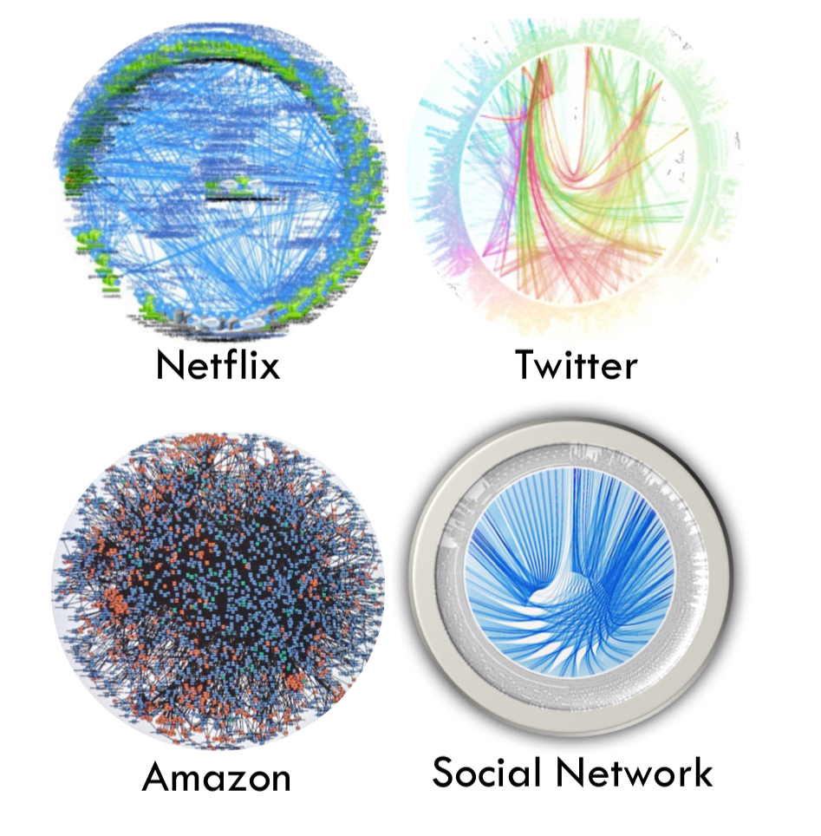
Death Star Architecture

Slide 59
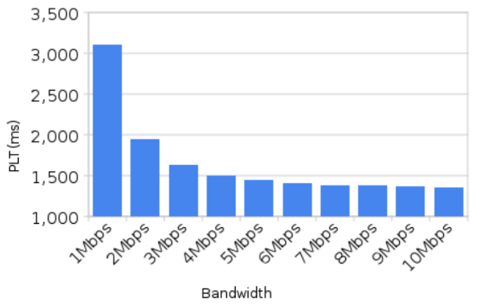
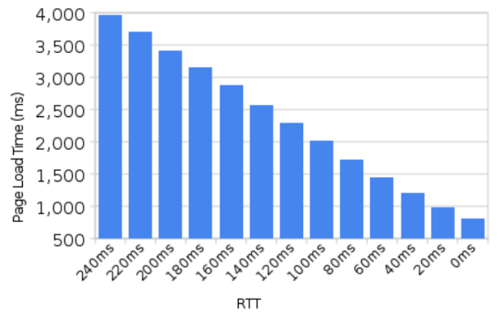
Latency
Notes:
https://tech-lagoon.com/imagechef/en/white-to-transparent.html

Slide 60
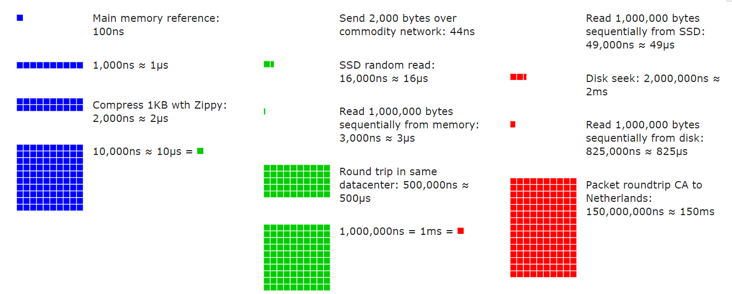
Latency Numbers Every Programmer Should Know

Slide 61
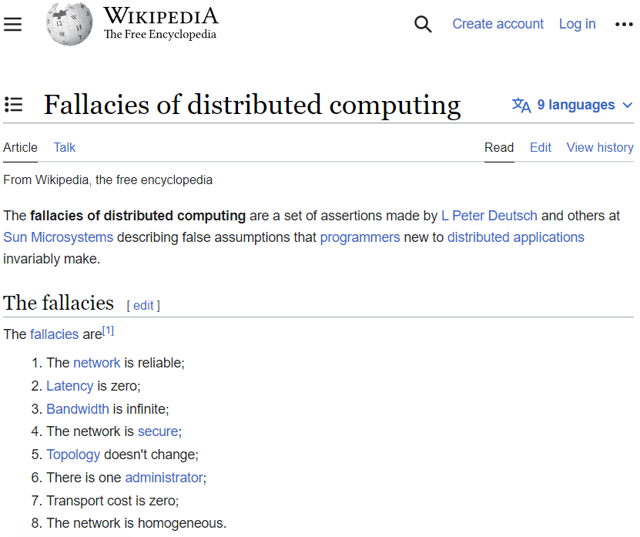
Notes:
Sun Microsystems
- CAP theorem

Slide 62
Conway’s Law
How does this affect us?
Notes:
Schema owner != Service Owner
“Be liberal in what you accept, and conservative in what you send” - https://www.rfc-editor.org/rfc/rfc1122
Schema Providers:
JSON Schema: https://json-schema.org/
Protocol Buffers: https://developers.google.com/protocol-buffers/
Avro: https://developers.google.com/protocol-buffers/
OpenAPI: https://www.openapis.org/
Schema Registry:
https://docs.confluent.io/platform/current/schema-registry
GraphQL Schema Federation:
https://www.apollographql.com/docs/federation/federated-types/overview/

Slide 63



Client Libraries
Amazon S3
Startup
Notes:
Love / Hate relationship (hands up)
Coarse grained API
Slowed startup
Shift left (build time)
Liveness / Readiness health
Fallacies of Distr. Systems

Slide 64

Client Libraries
Amazon S3
Startup
Notes:
Coarse grained API
Slowed startup
Shift left (build time)
Liveness / Readiness health
Fallacies of Distr. Systems

Slide 65
Client Libraries
Amazon S3
Health Check
Notes:
Coarse grained API
Slowed startup
Shift left (build time)
Liveness / Readiness health
Fallacies of Distr. Systems

Slide 66


Shift Left
Amazon S3
CI/CD
Notes:
Shift left (build time)
Mock container (S3)

Slide 67
Proxy
Proxy
Amazon S3

Slide 68

Thank You!
@gitaroktato
gitaroktato
https://www.linkedin.com/in/oresztesz
ORESZTÉSZ MARGARITISZ
ASSOCIATE CHIEF SOFTWARE ENGINEER
Notes:
TODO - SpeakerScore

Slide 69

Colors

